Slide 1

Web Traffic Time Series Forecasting
Forecast Future Traffic to Wikipedia Pages (Kaggle)
Team 2: Ellen Liu, Elly Yang, Joshua Dai, Mengyang Yu
Jun 2, 2021

Slide 2

Executive Summary
1 | 2 | 3 | 4 | 5 | 6 | 7 | 8 | 9
This deck provides an analysis and evaluation of the use of four different time series models for predicting web traffic, and makes a recommendation based on sample data and modeling results. The goal of this project is to predict web traffic using time series models and help institutions to be better prepared for potential web traffic congestion. The recommendation here is that outliers in datasets could distort prediction results and should be eliminated prior to modeling.

Slide 3
2. Business Case and Problem Statement
1 | 2 | 3 | 4 | 5 | 6 | 7 | 8 | 9
Website traffic are double-edged swords
high traffic increases profit
congestion leads to customer loss.
Based on the time series of daily views of different Wikipedia articles, we want to build forecasting models to predict the volume and peak period.

Slide 4
3. Model Hypothesis and Goals
1 | 2 | 3 | 4 | 5 | 6 | 7 | 8 | 9
correlations between internet trends and high webpage traffics
time point when webpages will experience high number of visits and cause potential congestion

Slide 5
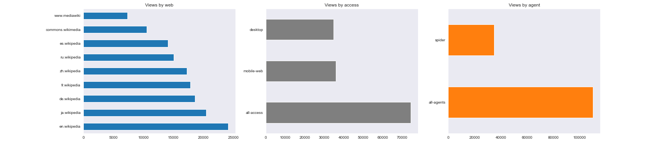
4. Data Description & Properties
1 | 2 | 3 | 4 | 5 | 6 | 7 | 8 | 9
803 days (columns): from 2015-07-01 to 2017-09-10
145,063 time series (rows): daily views of each web page
Page: <topic>_<web>_<access>_<agent>
ex. 2NE1_zh.wikipedia.org_all-access_spider

Slide 6
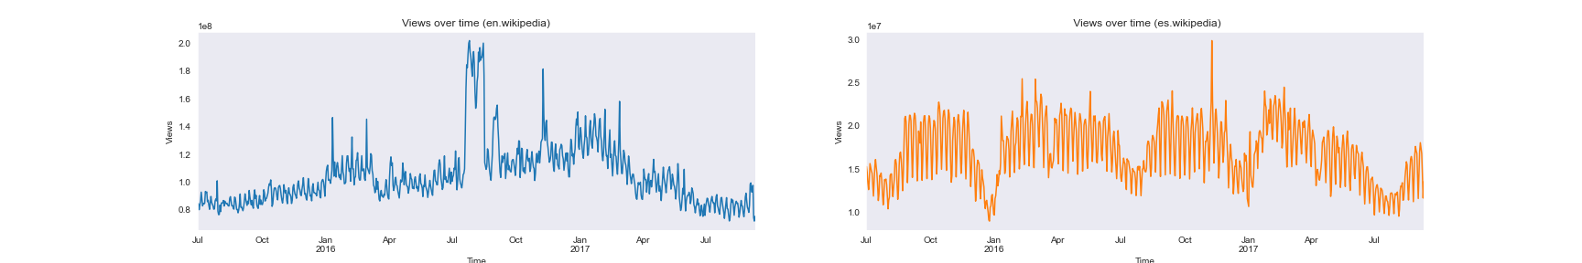
5. Data Preprocessing & EDA
1 | 2 | 3 | 4 | 5 | 6 | 7 | 8 | 9
en.wikipedia: more views (US-based site), large spikes in Aug 2016 (olympics) & Nov 2016 (election)
es.wikipedia: weekly seasonality, 6-month dip
ACF: large spikes every 7 days due to weekly seasonality
PACF: the first week has the largest spike

Slide 7
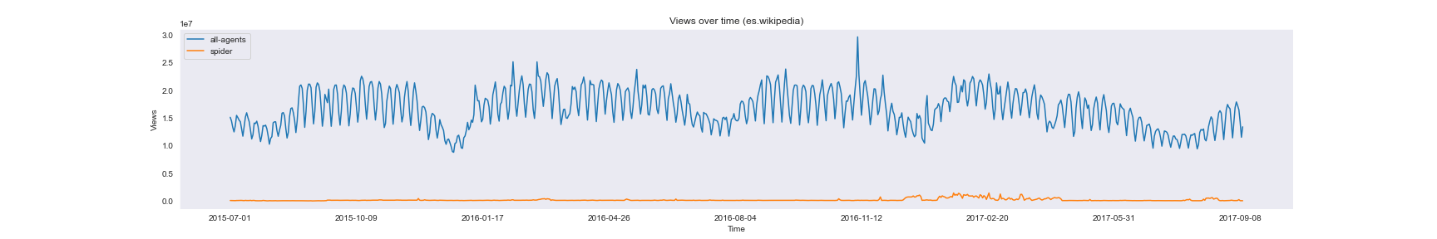
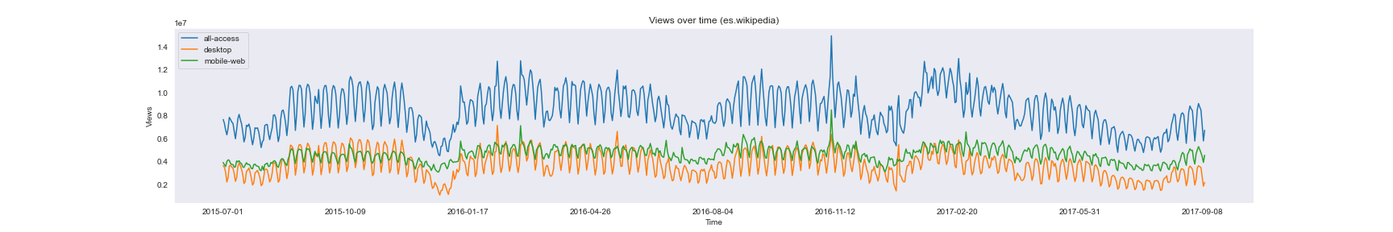
5. Data Preprocessing & EDA
1 | 2 | 3 | 4 | 5 | 6 | 7 | 8 | 9
es.wikipedia group by agent (all-agents vs spider): spider is approximately constant
es.wikipedia group by access (all-access vs desktop vs mobile-web): three groups have similar trends

Slide 8
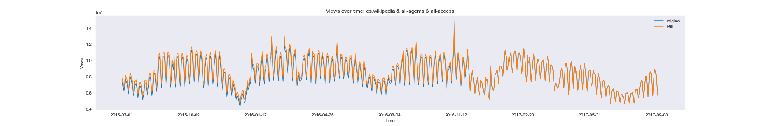
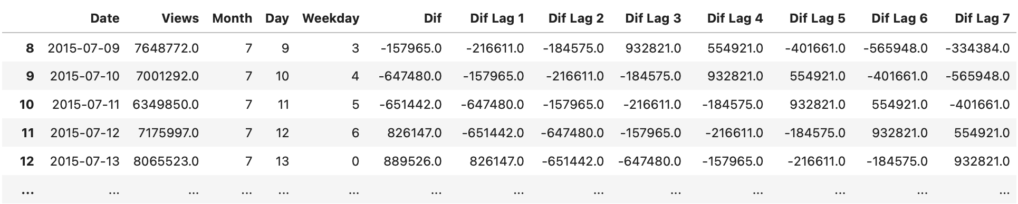
6. Feature Engineering
1 | 2 | 3 | 4 | 5 | 6 | 7 | 8 | 9
bfill final dataset (es.wikipedia + all-agent + all-access): 9.3% pages (329 out of 3537) have 1+ missing values
calculated fields

Slide 9
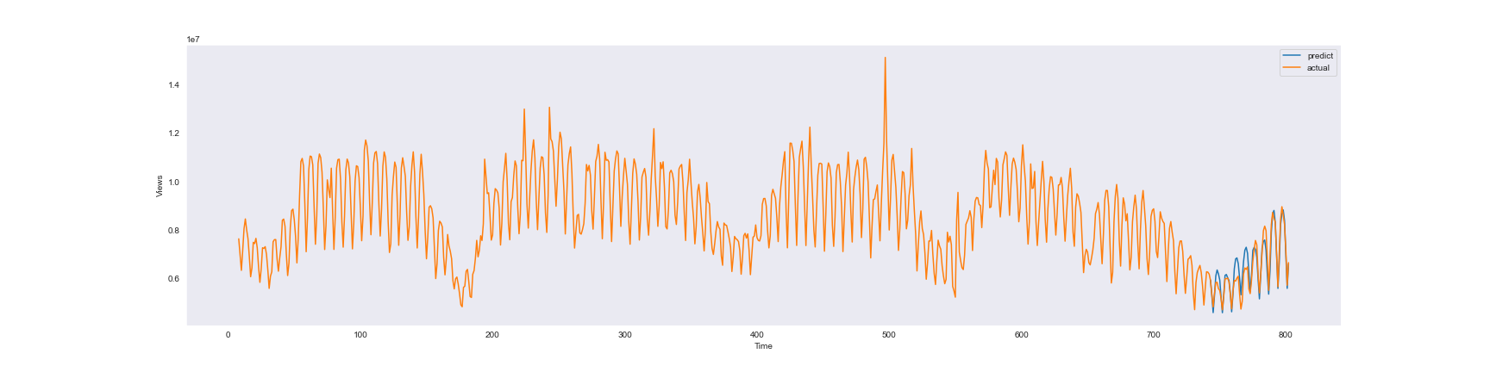
7.1 Modeling Approach: ML (ExtraTreesRegressor)
1 | 2 | 3 | 4 | 5 | 6 | 7 | 8 | 9
Variables
X: Month, Day, Weekday, Dif Lag 1~7
y: Dif
Prediction period: last 60 days
SMAPE: 5.02
MAPE: 0.05
MAE: 322307.12

Slide 10
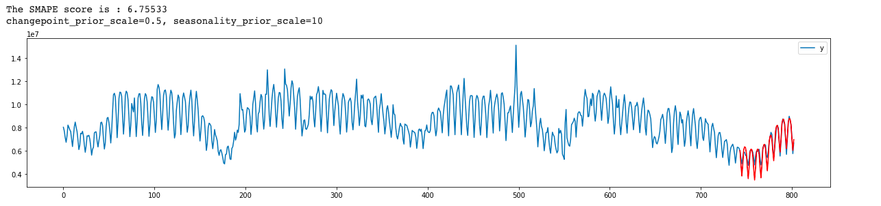
7.2 Modeling Approach: Prophet
1 | 2 | 3 | 4 | 5 | 6 | 7 | 8 | 9
Variables
X: date
y: sum of total views of Spanish wikipages
Prediction period: last 60 days
SMAPE: 6.76
MAPE: 0.06
MAE: 355137.92

Slide 11
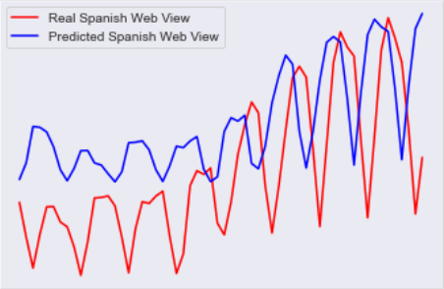
7.3 Modeling Approach: RNN
1 | 2 | 3 | 4 | 5 | 6 | 7 | 8 | 9
Variables
X: sum of total views of Spanish wikipages
y : sum of total views of Spanish wikipages of
five day later
Prediction period: last 60 days
SMAPE: 18.96
MAPE: 0.169
MAE: 1127518.28

Slide 12
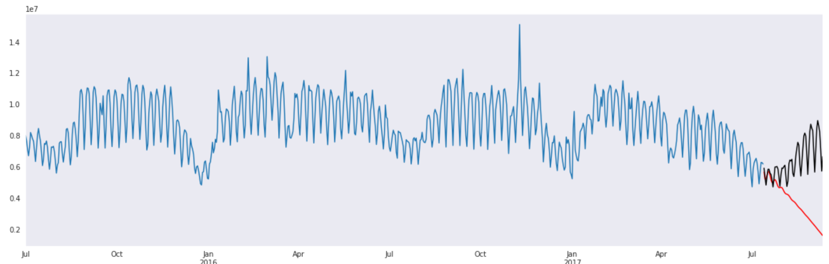
7.4 Modeling Approach: ARIMA
1 | 2 | 3 | 4 | 5 | 6 | 7 | 8 | 9
Variables
X: date
y : sum of total views of Spanish wikipages
Prediction period: last 60 days
SMAPE: 53.69
MAPE: 0.381
MAE: 2690831.55

Slide 13
8 Selected Model Results with Justifications and Tradeoffs
1 | 2 | 3 | 4 | 5 | 6 | 7 | 8 | 9
 | ML | Prophet | RNN | ARIMA
SMAPE | 5.02 | 6.76 | 18.96 | 53.69
MAPE | 0.05 | 0.06 | 0.169 | 0.381
MAE | 322307.12 | 355137.92 | 1127518.28 | 2690831.55

Slide 14
9.1 Insights - Weekly seasonality
1 | 2 | 3 | 4 | 5 | 6 | 7 | 8 | 9
1 | 2 | 3 | 4 | 5 | 6 | 7 | 8 | 9
es.wikipedia: weekly seasonality, 6-month dip (Nov 2016 (election))
ACF: large spikes every 7 days PACF: the first week has the largest spike

Slide 15
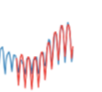
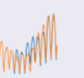
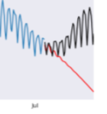
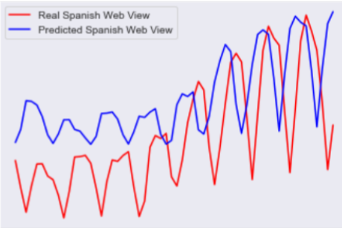
9.2 Insights - timeliness and seriousness prediction
1 | 2 | 3 | 4 | 5 | 6 | 7 | 8 | 9
Prophet ML (ExtraTreesRegressor) ARIMA
Timeliness - RNN
Predict ahead of time
Avoid high volume web traffic
Note: blue is predicted data, red is real data

Slide 16
9.2 Insights - timeliness and seriousness prediction
1 | 2 | 3 | 4 | 5 | 6 | 7 | 8 | 9
1 | 2 | 3 | 4 | 5 | 6 | 7 | 8 | 9
1 | 2 | 3 | 4 | 5 | 6 | 7 | 8 | 9
Prophet ML (ExtraTreesRegressor) ARIMA RNN
Seriousness prediction
Prophet and ML have larger volatility on prediction
Predict higher volume helps maintenance team make sufficient preparation
Send more people, update server...

Slide 17
Reference
https://www.kaggle.com/muonneutrino/wikipedia-traffic-data-exploration#Making-Predictions
https://www.kaggle.com/headsortails/wiki-traffic-forecast-exploration-wtf-eda
https://www.kaggle.com/zoupet/predictive-analysis-with-different-approaches

